Slide 1
Dispersants
CGPRT(W) : Ensuring Clean Seas and Coasts in Western Region ……

Slide 2
Aim
To understand the operational use of dispersants*
*The information provided in this lesson is, unless otherwise specified, referring to surface application of dispersant.
CGPRT(W) : Ensuring Clean Seas and Coasts in Western Region ……

Slide 3
Dispersants – How They Work
Dispersants promote the formation of small oil droplets in the water column facilitating dilution and biodegradation.
CGPRT(W) : Ensuring Clean Seas and Coasts in Western Region ……

Slide 4
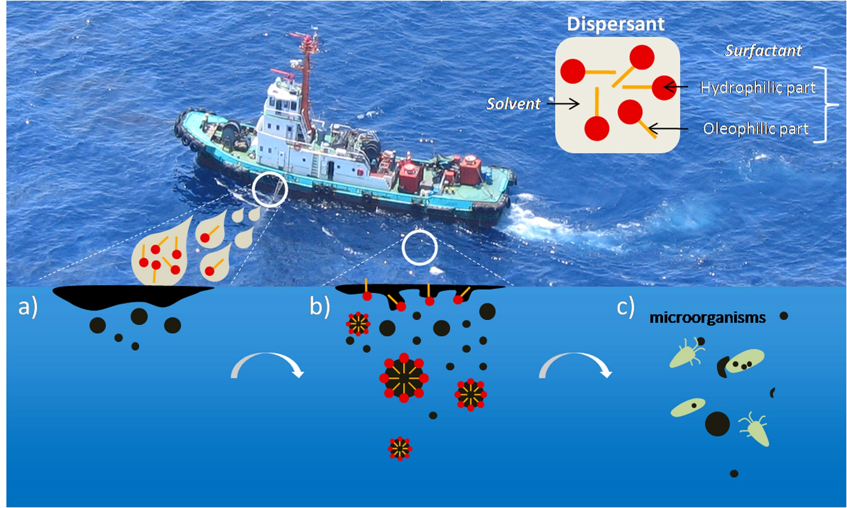
Mechanism of Chemical Dispersion
CGPRT(W) : Ensuring Clean Seas and Coasts in Western Region ……

Slide 5
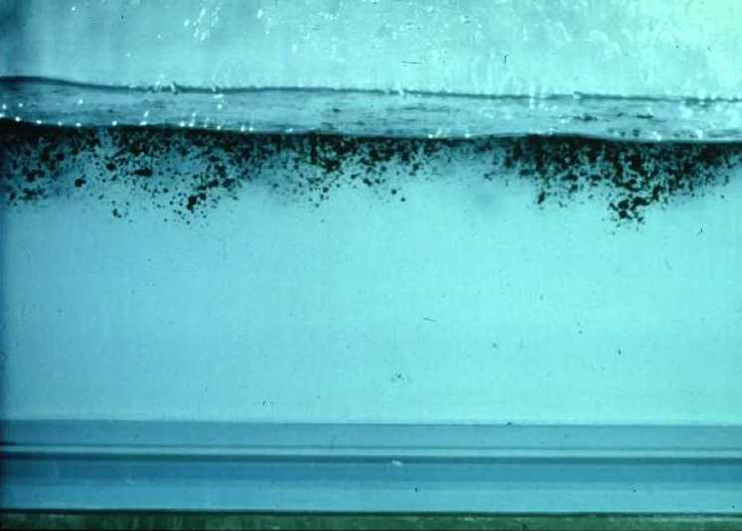
Natural Dispersion
CGPRT(W) : Ensuring Clean Seas and Coasts in Western Region ……

Slide 6
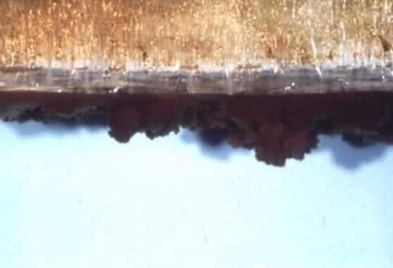
Dispersants Added
CGPRT(W) : Ensuring Clean Seas and Coasts in Western Region ……

Slide 7
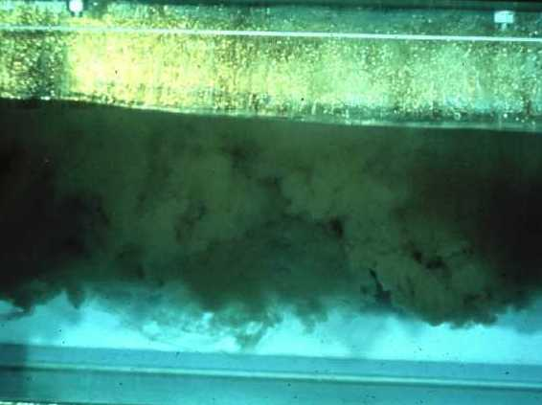
Dispersants Added
CGPRT(W) : Ensuring Clean Seas and Coasts in Western Region ……

Slide 8
Application Techniques
Guidance
Ship spraying
Airborne spraying
Subsea application
CGPRT(W) : Ensuring Clean Seas and Coasts in Western Region ……

Slide 9
Guidance
Conditions for application
  Sea conditions (wave energy required for mixing)
  Avoid sensitivities (aquaculture, corals, sea grass etc.)
  Water depth (> 10m)
  Salinity
  Oil viscosity
  Approval
CGPRT(W) : Ensuring Clean Seas and Coasts in Western Region ……

Slide 10
Guidance
Spotter aircraft should be used to guide dispersant application.
Fly above vessels or aircraft applying dispersant to guide operations and monitor effectiveness.
Guide vessels or aircraft to targets, and give start and stop cues – this also prevents over application and waste of dispersant.
CGPRT(W) : Ensuring Clean Seas and Coasts in Western Region ……

Slide 11
Guidance
Smoke bombs can be used to test for drift caused by wind prior to spraying.
Help pilots adjust application to minimize waste of droplets blown by the wind.
CGPRT(W) : Ensuring Clean Seas and Coasts in Western Region ……

Slide 12
Guidance
Crews on spotter aircraft must be trained and experienced to understand where the dispersant should be applied and know if it is being effective.
Good communication with spotter aircraft and aerial guidance procedures should be followed.
CGPRT(W) : Ensuring Clean Seas and Coasts in Western Region ……

Slide 13
Ship Spraying
Spray arms with calibrated nozzles are fitted to bow of vessel.
Dispersant is pumped from storage tank to spray arms.
Speed of the vessel will affect the concentration of dispersant being applied.
Repeated passes may be required for thicker slicks.
CGPRT(W) : Ensuring Clean Seas and Coasts in Western Region ……

Slide 14
Ship Spraying
Vessels are usually readily available, easy to load and cost effective.
May be difficult to view slick from the bridge due to limited height.
Spotter aircraft should be used to guide the vessel to the target.
Apply to thickest part of slick (not to sheen).
CGPRT(W) : Ensuring Clean Seas and Coasts in Western Region ……

Slide 15
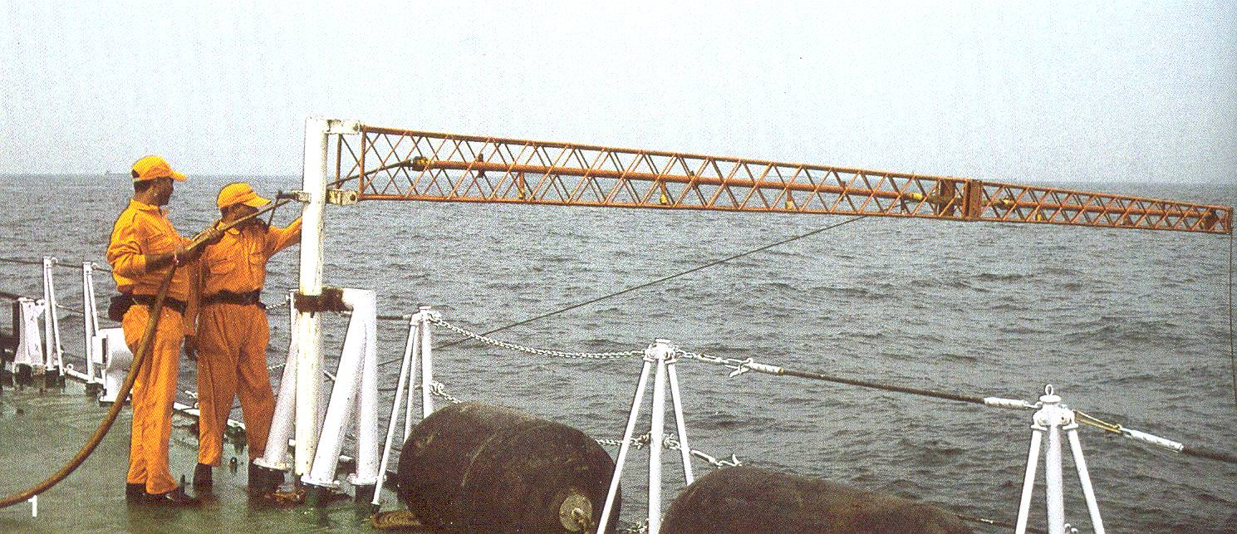
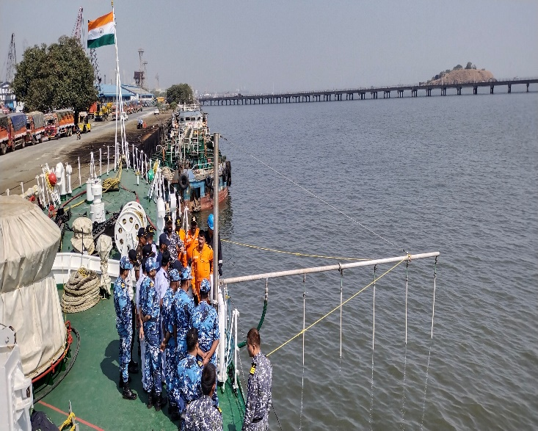
Ship Spraying
CGPRT(W) : Ensuring Clean Seas and Coasts in Western Region ……

Slide 16
Aerial Spraying
Helicopters and airplanes can usually be on site much faster than boats.
Large aircraft need fewer reloading trips for big spills but are less manoeuvrable.
Flight and dispersant crews must be well trained and exercised.
Applied from a low altitude.
CGPRT(W) : Ensuring Clean Seas and Coasts in Western Region ……

Slide 17
Aerial Spraying
Aircraft have better overview and visibility of spill than vessels.
High-flying spotter planes are needed to guide the operation and monitor effectiveness.
CGPRT(W) : Ensuring Clean Seas and Coasts in Western Region ……

Slide 18
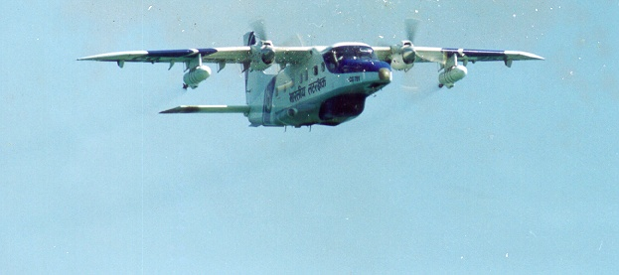
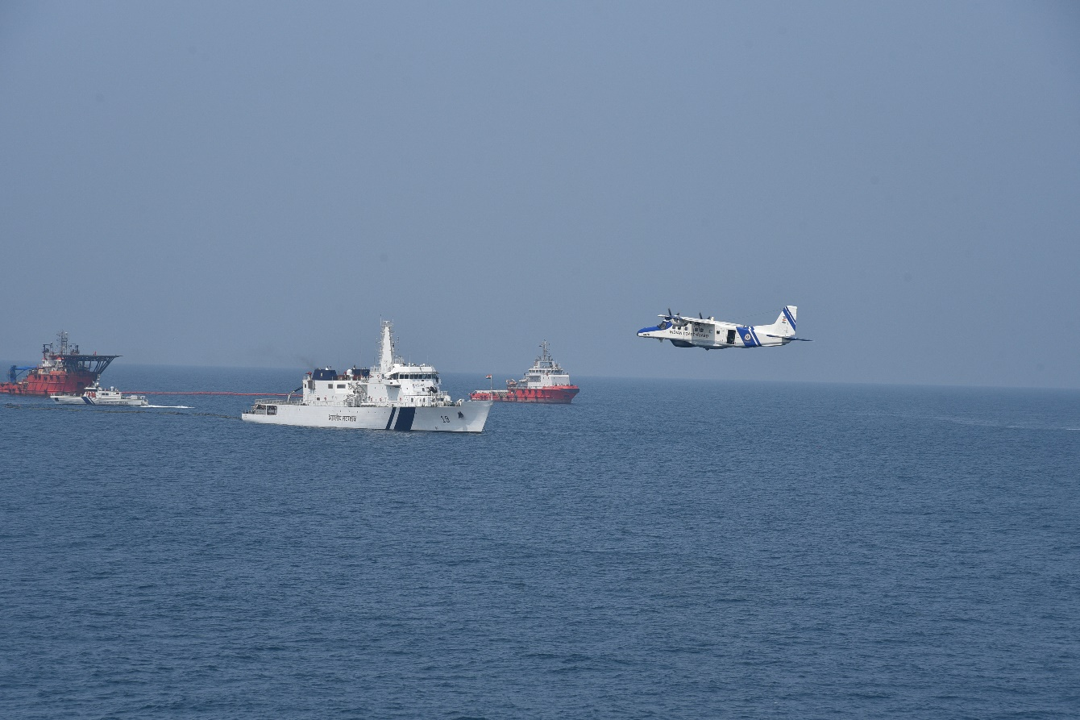
Airborne Spray Systems: Fixed Wing
CGPRT(W) : Ensuring Clean Seas and Coasts in Western Region ……

Slide 19
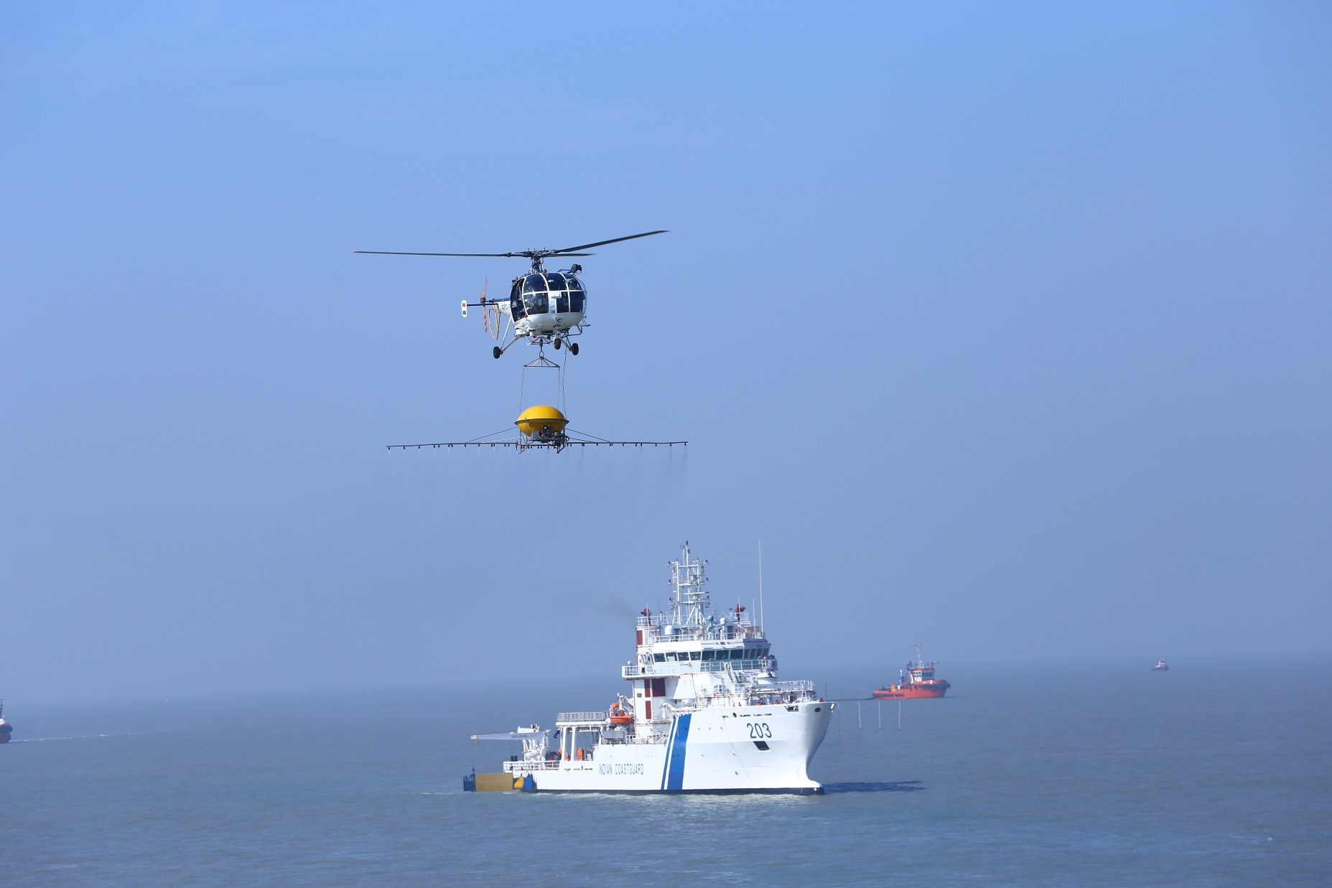
Airborne Spray System: Helicopter
CGPRT(W) : Ensuring Clean Seas and Coasts in Western Region ……

Slide 20
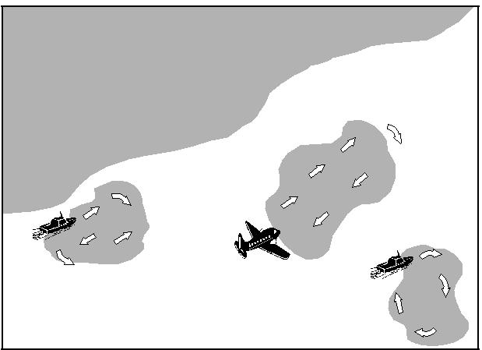
Application
CGPRT(W) : Ensuring Clean Seas and Coasts in Western Region ……

Slide 21
Subsea Dispersant
Application of dispersants directly at the well head.
May inhibit hydrocarbon vapours at the surface allowing responders and vessels to operate in a safer environment.
Used as a technique in Macondo response.
May require authorization prior to use.
Lack of environmental data to determine the ultimate fate of the dispersed oil at depth.
Impacts on the different layers in the water column unknown.
CGPRT(W) : Ensuring Clean Seas and Coasts in Western Region ……

Slide 22
Dispersant Logistics
Dispersant may be stored in barrels, IBCs or ISO tank containers or in bulk.
Regardless of storage method the dispersant needs to be:
  transported to site (airfield, dock, etc.)
  offloading and storage
  securely and safely stored
  handled safely and appropriately (SDS)
  transferred to the delivery vessel or aircraft
  dispersant use records maintained.
CGPRT(W) : Ensuring Clean Seas and Coasts in Western Region ……

Slide 23
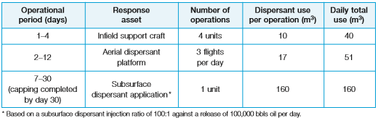
Dispersant Logistics
Consider usage requirements
  delivery system and duration of dispersant operations
  logistics and re-supply route
CGPRT(W) : Ensuring Clean Seas and Coasts in Western Region ……

Slide 24
Dispersant Logistics
Consider usage requirements:
  adequacy of temporary storage areas;
  any requirements for mixing, diluting or dosage rates;
  numbers of personnel involved;
  suitable PPE for personnel involved in mixing, transferring or delivering product;
  empty containers may need to be cleaned prior to removal;
  all containers removed and area restored on completion.
CGPRT(W) : Ensuring Clean Seas and Coasts in Western Region ……

Slide 25
Dispersant Application: Summary
Break up oil into small droplets facilitating dilution and natural degradation.
Should only be used in salt water with high degree of mixing energy.
Spraying should be concentrated on thickest layer.
Modern dispersants are less toxic and more effective than earlier generation types.
CGPRT(W) : Ensuring Clean Seas and Coasts in Western Region ……

Slide 26
Dispersants
Issues with dispersants use
  Oil viscosity and time
    Weathering processes will increase oil viscosity over time
    Dispersants must be applied before viscosity is too high
    “Window of opportunity”
  Sea state and weather
    Mixing energy from breaking waves is beneficial
    Weather conditions must permit application of dispersants
CGPRT(W) : Ensuring Clean Seas and Coasts in Western Region ……

Slide 27
Dispersants
Conflict with other response methods
  Coordination of all response methods is necessary to ensure dispersant use does not conflict with other techniques.
  Oil dispersed into the water column cannot be contained by booms or recovered by skimmers.
  The effectiveness of Oleophillic skimmers and sorbent materials can be significantly reduced by the use of dispersants.
CGPRT(W) : Ensuring Clean Seas and Coasts in Western Region ……

Slide 28
Dispersants - Monitoring
Effectiveness of chemical dispersion should be monitored continually.
Visual observation of effectiveness may be impaired by:
  Poor weather, high sediment waters, pale-coloured oils, poor light.
Effectiveness can be monitored by towing an ultra-violet fluorometer below the oil to measure the variation in oil concentrations.
Should be used with visual observation.
CGPRT(W) : Ensuring Clean Seas and Coasts in Western Region ……

Slide 29
Key Considerations
Vessels working near slick require proper air monitoring for crew safety.
Fire/explosion hazards due to vapours.
Proper PPE must be worn.
Relief crews may be needed to prevent over-tiring in challenging circumstances particularly flight crews.
Vessel decks should be cleaned as product on deck creates a slippery surface for crew.
CGPRT(W) : Ensuring Clean Seas and Coasts in Western Region ……

Slide 30
Key Considerations
Aircraft need regular inspections.
Aircraft may need regular rinsing with fresh water to prevent dispersant or salt water from damaging components.
Aircraft exclusion zones should be in place for aircraft safety.
CGPRT(W) : Ensuring Clean Seas and Coasts in Western Region ……

Slide 31
Any questions?
CGPRT(W) : Ensuring Clean Seas and Coasts in Western Region ……

